Slide 1
CAR Calibration Meeting CAR Review
AP Team
Catherine Qiu, Kawano Motomu, Samantha Bang and Simy Li
December 10, 2013

Slide 2
Exemplary CAR # 133911765 (Simy Li)

Slide 3
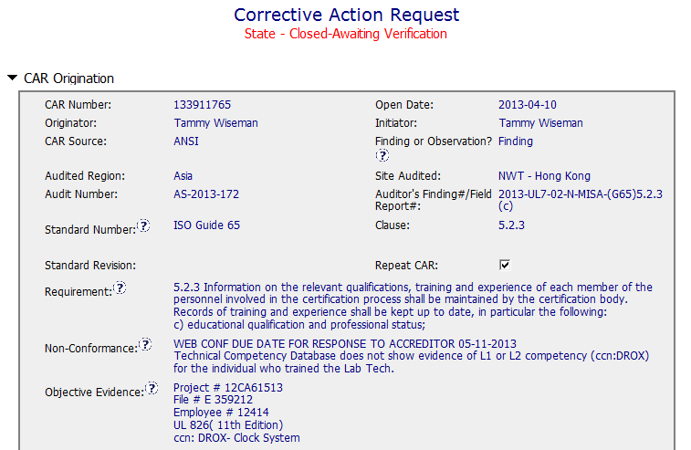
CAR# 133911765
Clear description of non-compliance – Lab Tech in training without evidence of qualified personnel to supervise the work done.
Notes:
For the CAR# 133911678:
[CAR Review based on 00-QA-S0006 - Corrective Action Request Process]
In the session of “Non-Conformance”, there are TWO (2) discrepancies:
Failure conducting Management Review in the required time period, and
Missing input element in the Management Review process. There should be two separate root cause analysis.

Slide 4
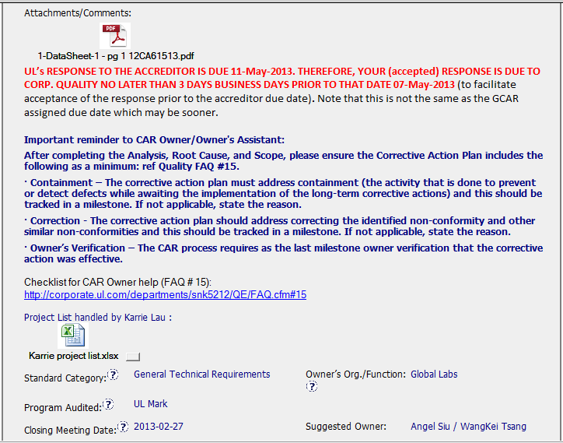
CAR# 133911765
Attached evidence of non-compliance (Datasheet)
Analysis evidence was attached here.
Collaboration (L) : Objective evidence are attached as needed.
Notes:
For the CAR# 133911678:
[CAR Review based on 00-QA-S0006 - Corrective Action Request Process]
In the session of “Non-Conformance”, there are TWO (2) discrepancies:
Failure conducting Management Review in the required time period, and
Missing input element in the Management Review process. There should be two separate root cause analysis.

Slide 5
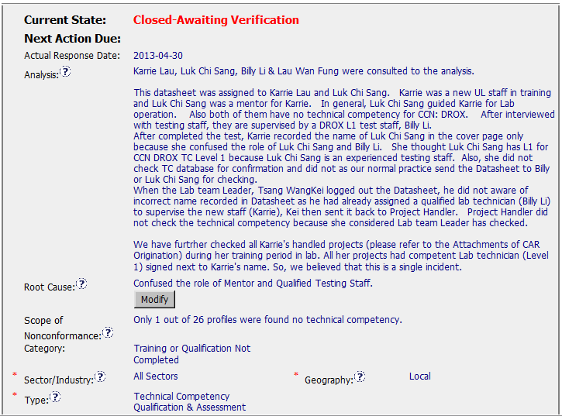
CAR# 133911765 (Analysis)
Key stakeholders identified
Clear path to root cause – confused the role of mentor and qualified testing staff
The checking for other impacted datasheets has been done as part of the analysis to help determine the scope: how widespread the problem was.
[Collaboration] (C) – Engage with CAR Owner to get deeper analysis.
[Competitiveness] (C) – Analysis shows clear path to root cause and scope and stakeholders identified.
[Competitiveness( (C) - Root cause statement is simple, reasonable and complete.
[Integrity] (T) – Most appropriate ‘category’, ‘type’, ‘geography’ are selected.
Notes:
Analysis – clear path to root cause; stakeholders identified
There are TWO (2) discrepancies: a) Failure conducting Management Review in the required time period, and b) Missing input element in the Management Review process. There should be two separate root cause analysis.
The “5 WHYs” approach hasn’t been utilized well because it doesn’t seem that it is able to identify the possible causes. For example, as mentioned in the “Analysis” field that “There was no general framework to set up an utilizable management review in that period. Thus the issue of the review has been postponed….” It is questionable whether it is specifically illustrated in the DEWI Quality Manual about the process and framework of Management Review, or the process is not even existing, or other reasons resulting now Management Review is not executed in the required timeframe after a personnel left the organization? The “5 WHYs” analysis can go further deeper.
In addition, does a statement “… Thus the issue of the review has been postponed.” mean that does the previous Management Review officially determine to be postponed? If yes, is there any supporting evidence?
And there is no analysis related to illustrate why “Recommendation for improvement” is not covered as input in the process of Management Review stated in the current DEWI Quality Manual.

Slide 6
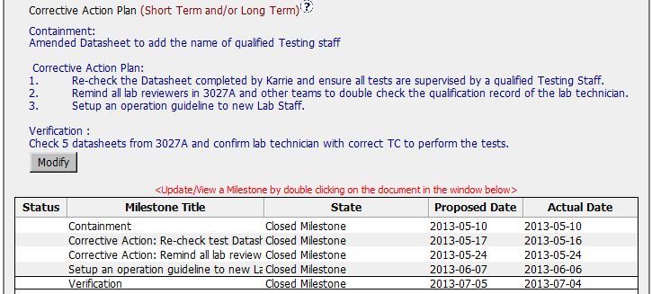
CAR# 133911765 (CAP)
Containment action : to fix the objective evidence
CAP :
Address entire root cause and items identified in the analysis. E.g.
Check entire datasheet done by Karrie
Set up an operation guide to avoid confusion of role
Remind the Lab reviewer as the gatekeeper
Verification : New records (DS) were reviewed to ensure CAP is effective
Milestones were set up accordingly
[Competitiveness] (C) – Corrective actions fix the objective evidence and other problems found; address entire root cause and scope.
[Competitiveness] (C) – Milestones address containment and owner’s verification; completed per milestone expectations.
[Competitiveness] (C) – Verification per requirements.
Notes:
Root Cause – is succinct; reasonable and complete based upon the analysis
Not quite sure whether how would the process and initiator of the Management Review be outlined in the Quality Manual or the related SOPs. For the instance, is there a deputy person being determined to keep running of the Management Review process for any reason the initiator is absence.
Absence of the initiator in this case is not necessary resulting the failure of the quality process. [Refer to back to the result of the root cause analysis]
As mentioned above, there should be two separate root cause analysis. Another root cause is not addressed and identified.
Scope – tells how widespread the problem is
The widespread of the discrepancy has not been addressed in this field. e.g. How would it be affected by division, operation team, function, area/region, and the time period?
Remarks: Prior to the CAR review, if I were the CAR Administrator, it is necessary to clarify what are the differences to the organizations of DEWI and DEWI Wilhelmshaven, are they different entities? And is there any operation connection to DEWI-OCC?

Slide 7
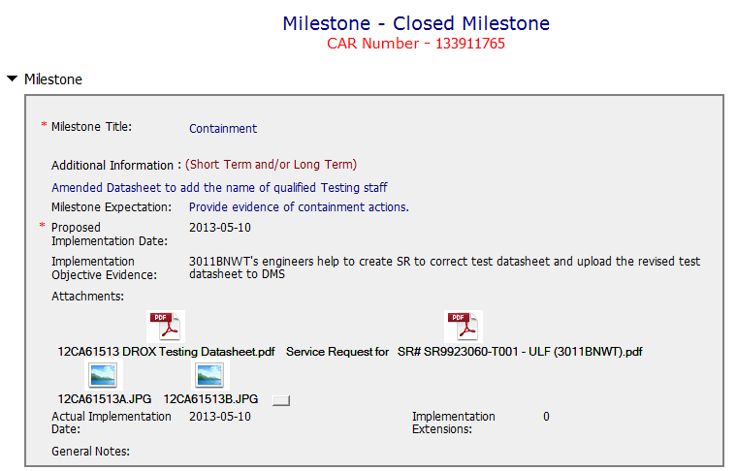
CAR# 133911765 (Containment Milestone)
Containment action is to fix the problem first.
Issue SR to correct the test datasheet. Evidence was attached.
[Collaboration] (C) – Referenced documents are attached as needed.
Notes:
Category
→ Satisfaction
Sector/Industry
→ Satisfaction
Type
→ Satisfaction
Geography – apparent from the analysis
Not clearly illustrated in the field of “Analysis” to support it to be “Regional”.

Slide 8
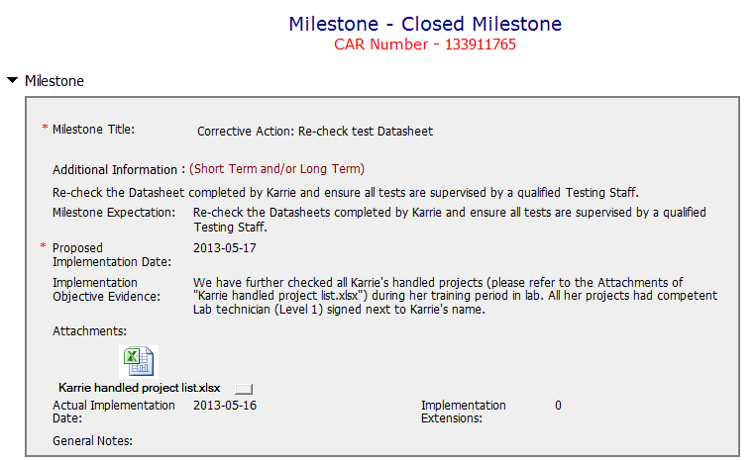
CAR# 133911765 (Milestone)
Milestone to address entire possible errors.
[Competitiveness] (C) – Milestones completed per milestone expectation.
Notes:
Corrective Actions – fix the objective evidence
If it only addresses the Containment to the “Root Cause” recorded above, I think it is sufficient…
However, the reason of why failure conducting of previous Management Review is not addressed in the fields of “Root Cause” and “Correction Action Plan”.
Corrective Actions – address the entire root cause
As noted above, it is sufficient to cover the containment action though, the corrective action managing the root cause has not been addressed.
Again, there is no any corrective action related to address why “Recommendation for improvement” is not covered as input in the process of Management Review stated in the current DEWI Quality Manual.
Corrective Actions – address the items identified in the analysis
As noted above.
Corrective Actions – cover the scope and geography
Comment as stated in “Geography” above.

Slide 9
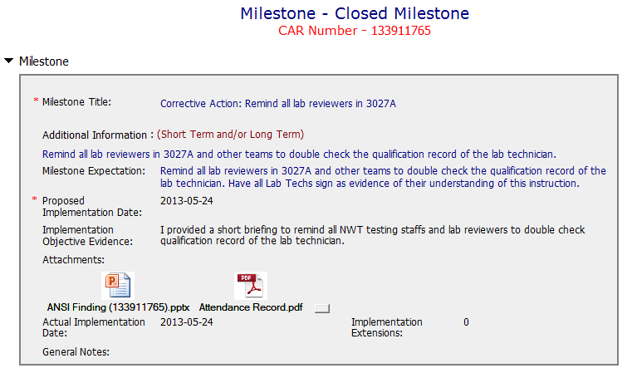
CAR# 133911765 (Milestone)
Briefing with attendance record.
[Collaboration] (L) – Referenced communications are attached as needed.
Notes:
Good and no abnormality is found.

Slide 10
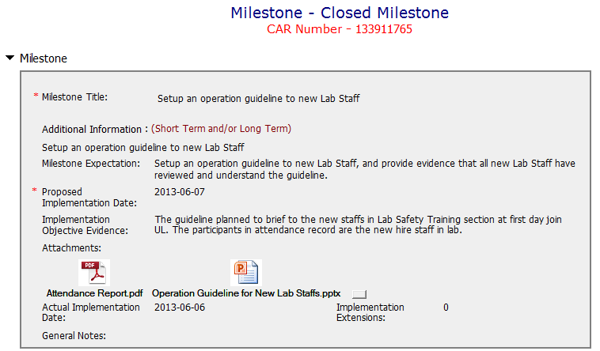
CAR# 133911765 (Milestone)
Milestone to address the entire root cause – Confusion of the role of Mentor and qualified testing staff
[Collaboration] (L, C L) – Good. Containment and its supporting evidence are reviewed appropriately.
Notes:
Milestones – address containment unless CAP indicates reason why not required
Milestone solely for containment is good but not for corrective action. [Suggest to inviting a person could read German for verification whether “Recommendation for improvement” is now covered as input in the process of Management Review.]
See below comments for corrective actions.

Slide 11
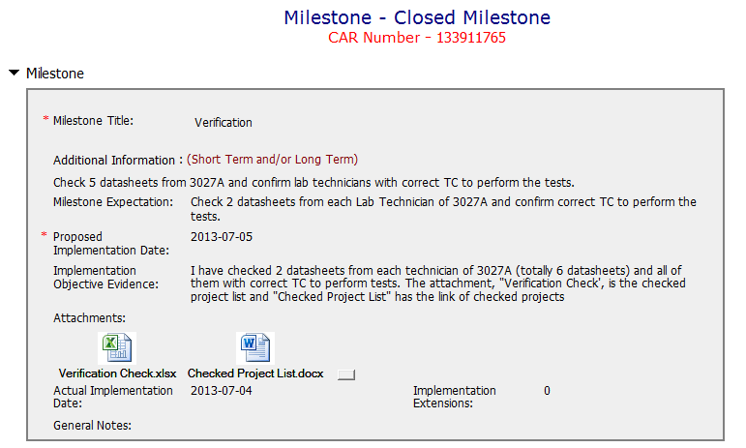
CAR# 133911765 (Verification Milestone)
Examined new datasheets to ensure that implemented corrective actions were effective.
[Competitiveness] (P) – Verification per requirements.
[Integrity] (T) – Acts on CARs within required timeframe. No extension is required.
Notes:
Milestones – have final milestone for owner’s verification of effectiveness; enough time is allowed for new records to be examined
Although CAR owner self-verification is added at the last milestone, it doesn’t cover the corrective action for the failure conducting previous Management Review.
In fact, would the next round of Management Review be able to conducted on-time, it has not been addressed.
It is suggested that the verification should focus on whether the updated process and/or next round of Management Review is in place to avoid recurrence of such nonconformity.
Milestones – completed per milestone expectations
It is acceptable as Containment Action for the supporting evidence covered in the 1st milestone, i.e. Management Review Report for Year 2011 and Year 2012 [Suggest to inviting a person could read German for verification…].
However, the evidence “Attachment of the management review 2013 in milestone one. The effectiveness of the management review was reviewed by the EULA Region Quality Manager and found to be acceptable.” stated in the 2nd milestone is irrelevant while the Management Review for Year 2013 has not been conducted yet. Not sure how CAR Administrator accepts it.
In addition, for 2nd milestone, it is suggested that a statement should be provided by CAR Owner to indicate that “Recommendation for improvement” is now covered as input in the process of Management Review for Year 2011 and 2012...

Slide 12
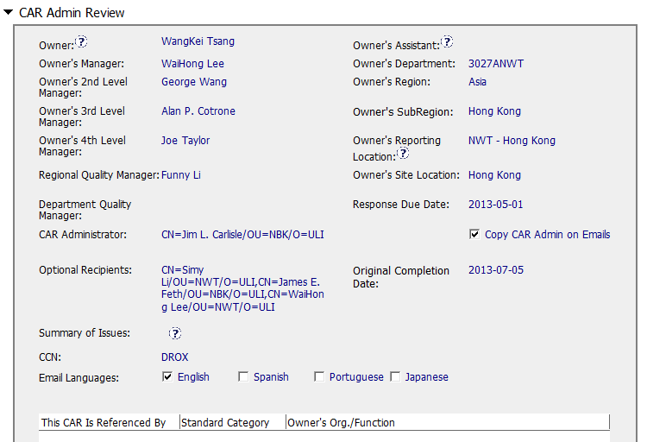
CAR# 133911765 (CAR Admin Review)
Correct input of Owner’s reporting manager.
Enter concerned personnel as optional recipients.
[Integrity] (T) – Accurately completes the administrative fields within the CAR such as Owner’s 4th Level Manager, Optional Recipients.
Notes:
Verification – completed within 6 months of CAR closure or explanation provided; enough time is allowed for new records to be examined
Please be noted that this CAR hasn’t been closed yet. It is still under a state of “Closed Awaiting Verification”, hence, the field of “Verification Evidence” is still kept empty.
However, when both root cause identification and the related corrective action stated in 2nd milestone are questionable, the comment “The corrective action was effective” stated in the field of “CAR Effectiveness Indicator” shows too generic and lack of logical consideration…
If I were the CAR Administrator, will suggest the CAR Owner to reconsider the revisit of the current Management Review process and hence fill up the loophole resulting this nonconformance by adding one or two more milestones to illustrate and support the proper completion of corresponding efforts / activities. The timeline of last milestone for CAR Owner self-verification could be set right after completion of Management Review for Year 2013.
For the “General Notes”, shouldn’t it be an analysis field provided by CAR Owner instead of CAR Admin?

Slide 13
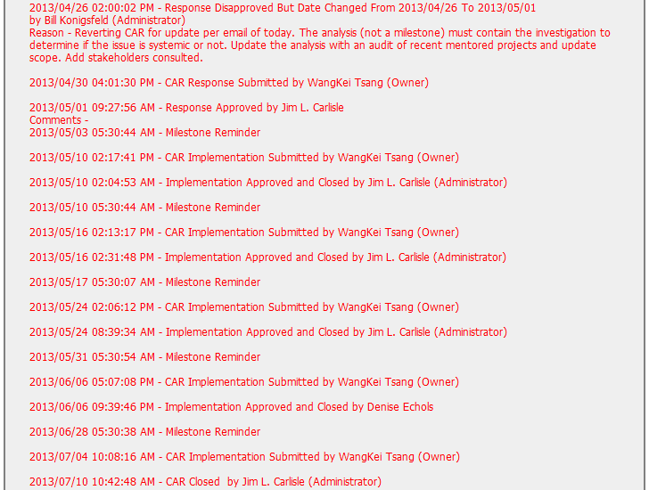
CAR# 133911765 (Extension)
CAR owner revised the analysis (to audit all Karrie’s handled projects to determine the widespread of the scope) as per the CAR Administrator’s advice.
[Collaboration] (C) – Works as a team player with other CAR Champion.
[Integrity] (T) – Acts on CARs within required timeframe.
[Integrity] (C, L) – Extensions are <30 days, 3 or less.
Notes:
Extensions – within requirements (<30 days, 3 or less)
The number of extensions is still meeting the requirement.
Other than this, suggest sending e-mail in advance to remind CAR Owner separately to avoid CAR overdue and/or escalation. Put the communication with CAR Owner into the CAR DB as evidence.

Slide 14
CAR# 133911765 (Overall Comment)
Good analysis of the finding CAR as further checking on the affected projects in order to determine how widespread of the noncompliance.
Good identification of root cause. Corrective actions are taken based on the root cause identified.
Collaboration between CAR Champions (Bill and Jim support each other) and CAR owner (CAR Owner acted on advice received from Jim).
Notes:
Milestones – have final milestone for owner’s verification of effectiveness; enough time is allowed for new records to be examined
Although CAR owner self-verification is added at the last milestone, it doesn’t cover the corrective action for the failure conducting previous Management Review.
In fact, would the next round of Management Review be able to conducted on-time, it has not been addressed.
It is suggested that the verification should focus on whether the updated process and/or next round of Management Review is in place to avoid recurrence of such nonconformity.
Milestones – completed per milestone expectations
It is acceptable as Containment Action for the supporting evidence covered in the 1st milestone, i.e. Management Review Report for Year 2011 and Year 2012 [Suggest to inviting a person could read German for verification…].
However, the evidence “Attachment of the management review 2013 in milestone one. The effectiveness of the management review was reviewed by the EULA Region Quality Manager and found to be acceptable.” stated in the 2nd milestone is irrelevant while the Management Review for Year 2013 has not been conducted yet. Not sure how CAR Administrator accepts it.
In addition, for 2nd milestone, it is suggested that a statement should be provided by CAR Owner to indicate that “Recommendation for improvement” is now covered as input in the process of Management Review for Year 2011 and 2012...

